Slide 1


Working Within the Data Lake
With AWS Glue

Slide 2
Table of contents
Optimizing for Cost and Performance
Cataloging Data Schemas with AWS Glue
Transforming Data with AWS Glue

Slide 3





























Session’s Focus – Working In The Data Lake
Amazon
Amazon Elasticsearch
AWS
Glue
AWS
AppSync
Amazon API Gateway
Amazon Cognito
DynamoDB Service
Access & User Interfaces
Catalog & Search
Central Storage
Scalable, secure, cost- effective
Amazon Athena
Amazon EMR
AWS
Glue
Amazon Redshift
Amazon DynamoDB
AWS
Snowball
Amazon Kinesis Data Firehose
AWS Direct Connect
AWS Database Migration Service
AWS Storage Gateway
S3
Manage & Secure
Amazon QuickSight
Amazon Kinesis
Amazon Elasticsearch Service
Amazon Neptune
Amazon RDS
AWS
DataSync
AWS Transfer for SFTP
Amazon S3 Transfer Acceleration
Analytics & Serving
AWS KMS
AWS IAM
AWS
CloudTrail
Amazon CloudWatch
Data Ingestion

Slide 4
Optimizing for Cost and Performance

Slide 5

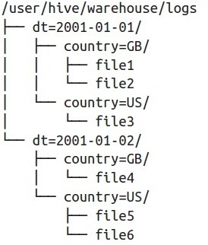





Optimizing for Cost and Performance
Partitioning
Pay for data your query needs, not to scan all of your data
Compression
Pay for what you store, not for what you process
Managed Services
Pay for what you use, not for what you run

Slide 6
Partitioning
datalake
├── | 20170515T1423-GB-01.tar.gz
├── | 20170515T1423-GB-02.tar.gz
├── | 20170515T1500-US-01.tar.gz
├── | 20170516T1500-US-01.tar.gz
├── | 20170516T1600-GB-01.tar.gz
└── | 20170516T1600-GB-02.tar.gz
datalake
├── dt=20170515
│ ├── country=GB
│ │ ├── 20170515T1423-GB-01.tar.gz
│ │ └── 20170515T1423-GB-02.tar.gz
│
│
└── country=US
└── 20170515T1500-US-01.tar.gz
└── dt=20170516
├── country=GB
│ ├── 20170516T1600-GB-01.tar.gz
│ └── 20170516T1600-GB-02.tar.gz
└── country=US
└── 20170516T1500-US-01.tar.gz
select * from datalake where
dt=20170515 and country=US

Slide 7
Partitioning - Advantages
 | select count(*) from datalake where dt=‘20170515’ |  | select count(*) from datalake where dt >= ‘20170515’ and dt < ‘20170516’
 | Non-Partitioned | Partitioned | Non-Partitioned | Partitioned
Run Time | 9.71 sec | 2.16 sec | 10.41 sec | 2.73 sec
Data Scanned | 74.1 GB | 29.06 MB | 74.1 GB | 871.39 MB
Cost | $0.36 | $0.0001 | $0.36 | $0.004
Results | 77% faster, 99% cheaper |  | 73% faster, 98% cheaper

Slide 8
Compression
Compressing your data can speed up your queries significantly
Splittable formats enable parallel processing across nodes
Algorithm | Splittable | Compressio n Ratio | Algorithm Speed | Good For
Gzip (DEFLATE) | No | High | Medium | Raw Storage
bzip2 | Yes | Very High | Slow | Very Large Files
LZO | Yes | Low | Fast | Slow Analytics
Snappy | Yes and No * | Low | Very Fast | Slow & Fast Analytics
* Depends on if the source format is splittable and can output each record into a Snappy Block

Slide 9
Compression - Example
Snappy Compression with Parquet File Format
Format | Size on S3 | Run Time | Data Scanned | Cost
Text | 1.15 TB | 3m 56s | 1.15 TB | $5.75
Parquet | 130 GB | 6.78s | 2.51 GB | $0.013
Result | 87% less | 34x faster | 99% less | 99.7% savings

Slide 10
Compression – File Counts
Fewer, larger files are better than many, smaller files (when splittable)
Faster Listing Operations
Fewer Requests to Amazon S3
Less Metadata to Manage
Faster Query Performance
Query | # files | Run Time
select count(*) from datalake | 5000 files | 8.4 sec
select count(*) from datalake | 1 file | 2.31 sec
Result |  | 72% Faster

Slide 11
Cataloging and Transforming Data
Working with AWS Glue

Slide 12

Discover
Automatically discover and categorize your data making it immediately searchable and queryable across data sources
Develop
Generate code to clean, enrich, and reliably move data between various data sources
Deploy
Run your jobs on a serverless, fully managed, scale-out environment. No compute resources to provision or manage.

Slide 13






AWS Glue: Components
Hive Metastore compatible with enhanced functionality
Crawlers automatically extracts metadata and creates tables
Integrated with Amazon Athena, Amazon EMR and many more
Data Catalog
Auto-generates ETL code
Build on open frameworks – Python/Scala and Apache Spark
Developer-centric – editing, debugging, sharing
Job Authoring
Run jobs on a serverless Spark platform
Provides flexible scheduling , Job monitoring and alerting
Job Execution
Orchestrate triggers, crawlers & jobs
Author & monitor entire flows and Integrated alerting
Job Workflow

Slide 14
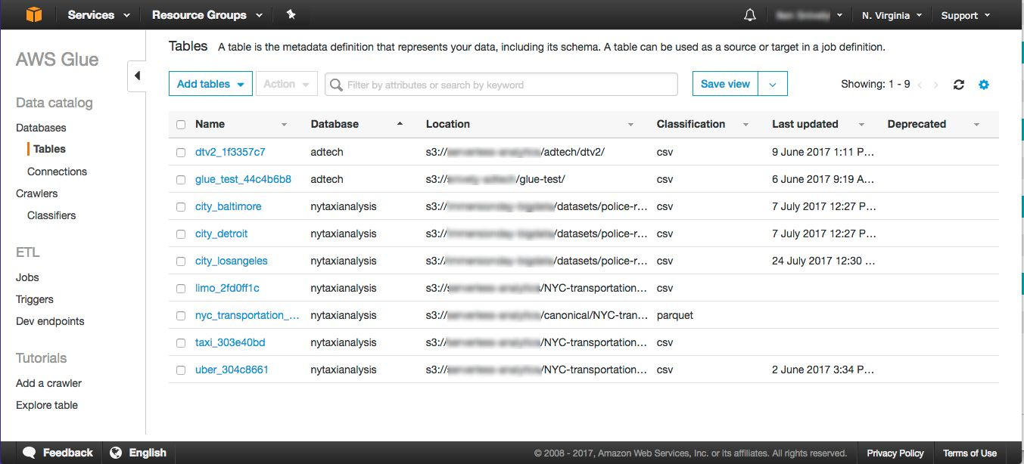
Glue: Data Catalog
Features Include
Search metadata for data discovery
Connections to S3, RDS, Redshift, JDBC, and DynamoDB
Classification for identifying and parsing files
Versioning of table metadata as schemas

Slide 15













Glue: Data Catalog – Queryable by Many Services
Glue ETL
Amazon Athena
Glue Data Catalog
Redshift Spectrum
EMR
(Hadoop/Spark)

Slide 16
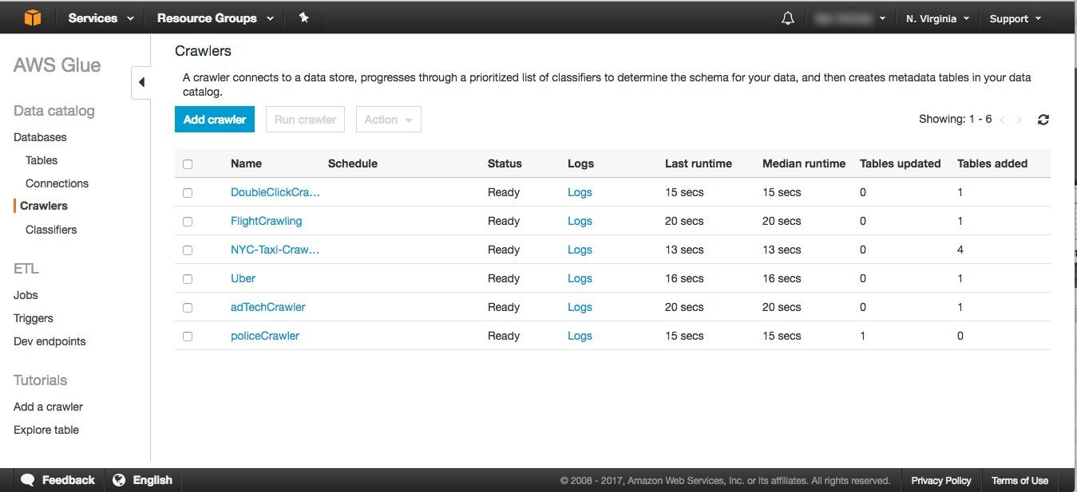
Glue: Data Catalog - Crawlers
Features Include:
Built-in classifiers
Detect file type
Extract schema
Identify partitions
On-Demand or Scheduled
Execution
Build-you-own classifiers
Grok for ease of use

Slide 17










Create additional Custom Classifiers with Grok!
Crawlers: Classifiers
IAM Role
Built-In Classifiers
Databases
MySQL
MariaDB
PostreSQL
Glue Crawler
Amazon RDS
Aurora
Redshift
Data Warehouse
JDBC Connection
Avro Parquet ORC
JSON & BJSON
Logs
(Apache, Linux, MS, Ruby, Redis, and many others)
Delimited
(comma, pipe, tab, semicolon)
Compressed Formats
(ZIP, BZIP, GZIP, LZ4, Snappy)
Amazon Redshift
Object Connection
Data Lakes
Amazon S3

Slide 18
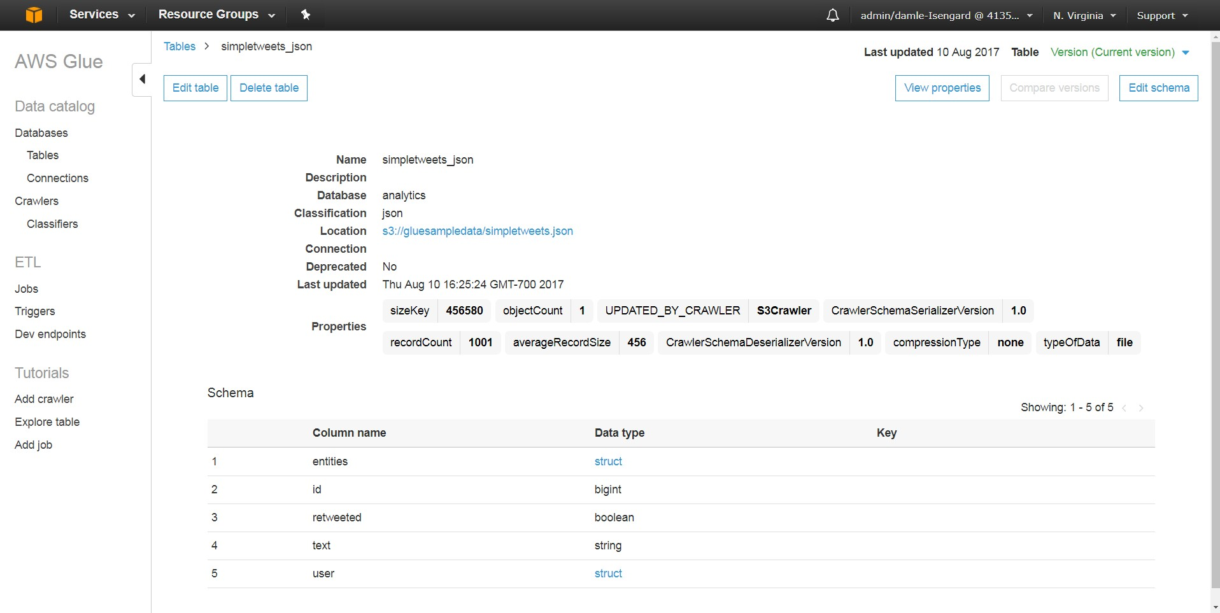



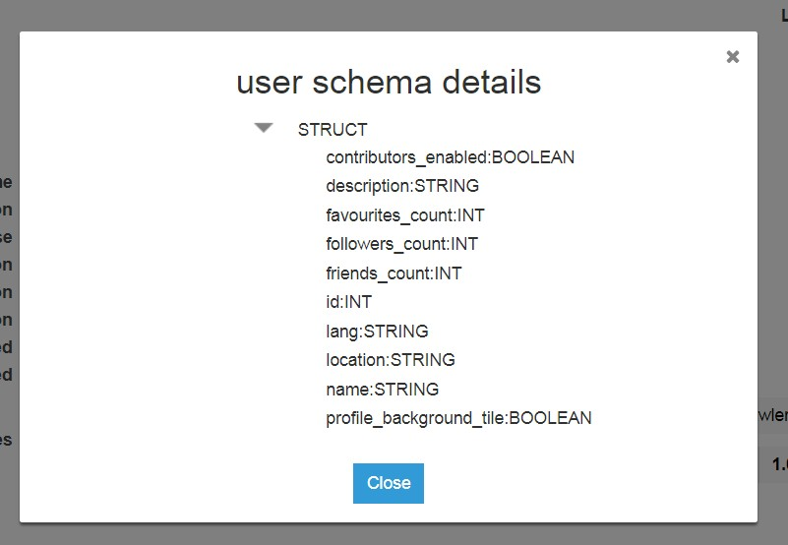

Data Catalog: Table details
Table properties
Data statistics
Table schema

Slide 19


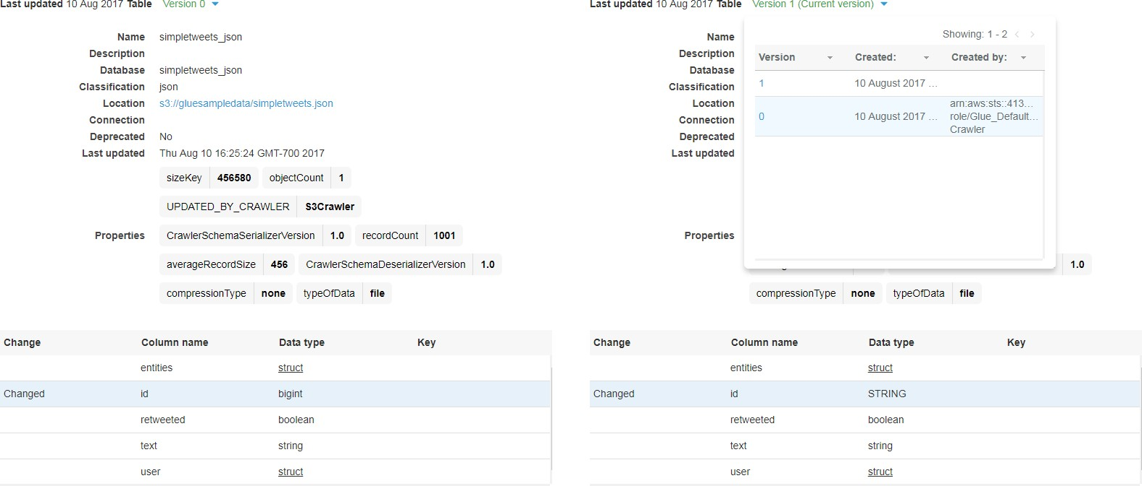
Data Catalog: Version control
Compare schema versions
List of table versions

Slide 20

Glue: Crawlers – Detecting Schema and Partitions
S3 bucket hierarchy
Table definition
Column | Type
month | str
date | str
col 1 | int
col 2 | float
month=No v
sim=.93
date=1 0
…
date=15
sim=.99
sim=.95
file 1
…
file N
file 1
…
file N

Slide 21
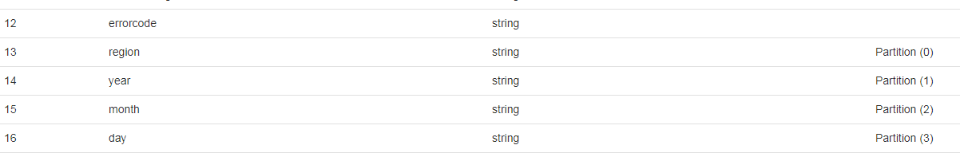


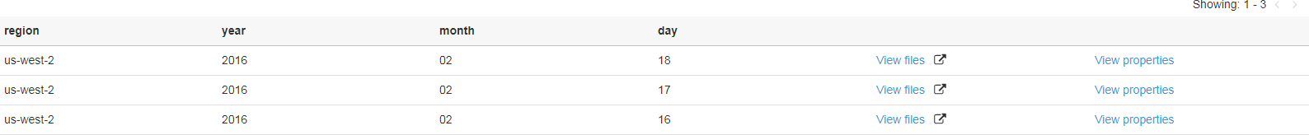
Data Catalog: Automatic partition detection
Table partitions
Automatically register available partitions

Slide 22
AWS Glue: Components
Hive Metastore compatible with enhanced functionality
Crawlers automatically extracts metadata and creates tables
Integrated with Amazon Athena, Amazon EMR and many more
Data Catalog
Auto-generates ETL code
Build on open frameworks – Python/Scala and Apache Spark
Developer-centric – editing, debugging, sharing
Job Authoring
Run jobs on a serverless Spark platform
Provides flexible scheduling , Job monitoring and alerting
Job Execution
Orchestrate triggers, crawlers & jobs
Author & monitor entire flows and Integrated alerting
Job Workflow

Slide 23
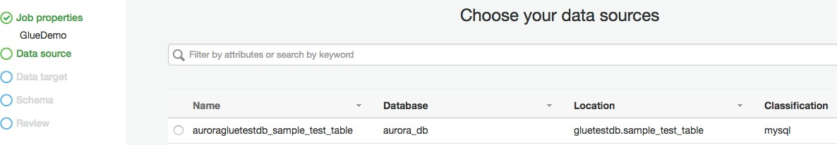
AWS Glue: Job Authoring - Pick a Source
Choose from Manually-Defined or Crawler-Generated Sources:
S3 Bucket
RDBMS
Redshift
DynamoDB

Slide 24
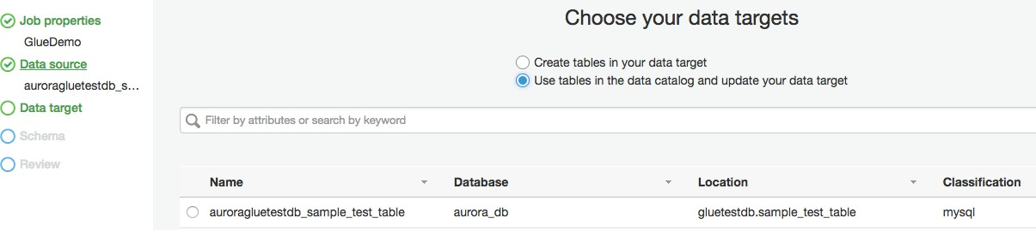
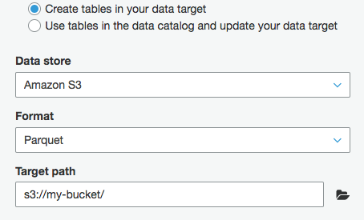
AWS Glue: Job Authoring – Pick a Target
Write output results into an existing table.
Crawler-Defined or Manually-Created:
S3 Bucket
RDBMS
Redshift

Slide 25
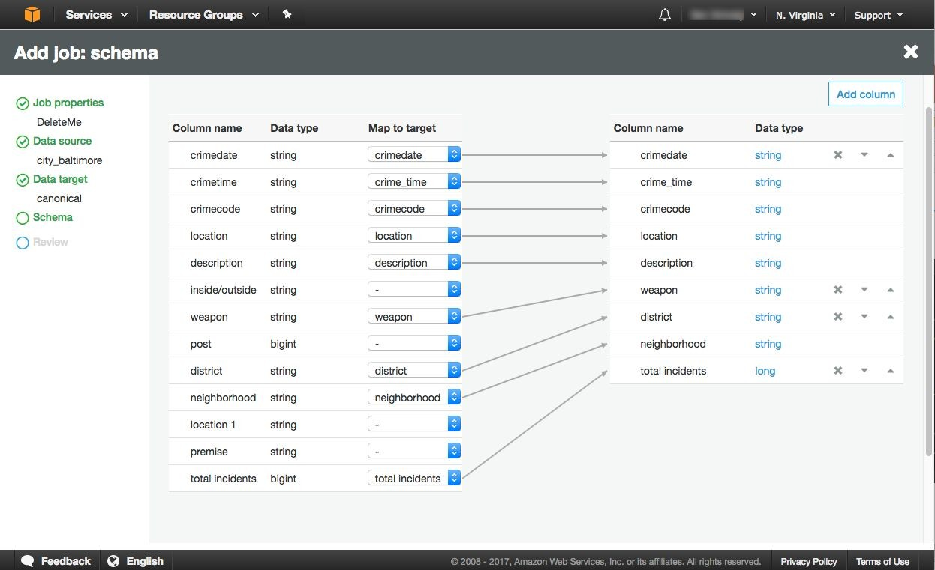


AWS Glue: Job Authoring – Apply Transformation
Existing columns in target
Can extend/add new columns to target

Slide 26
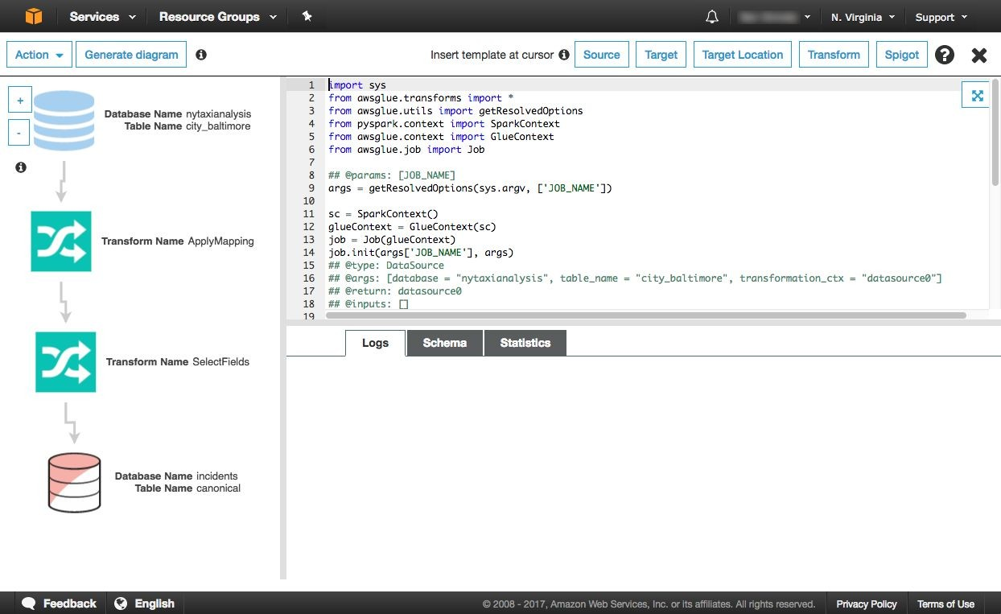

AWS Glue: Job Authoring – Code Generation
Customize the mappings
Glue generates transformation graph and either Python or Scala code
Specify trigger condition

Slide 27
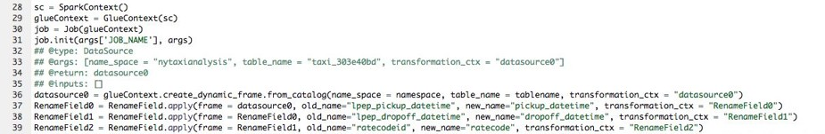
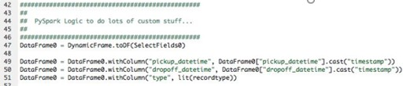
Job authoring: ETL code
Human-readable, editable, and portable PySpark or Scala code
Flexible: Glue’s ETL library simplifies manipulating complex, semi-structured data
Customizable: Use native PySpark / Scala, import custom libraries, and/or leverage Glue’s libraries
Collaborative: share code snippets via GitHub, reuse code across jobs

Slide 28
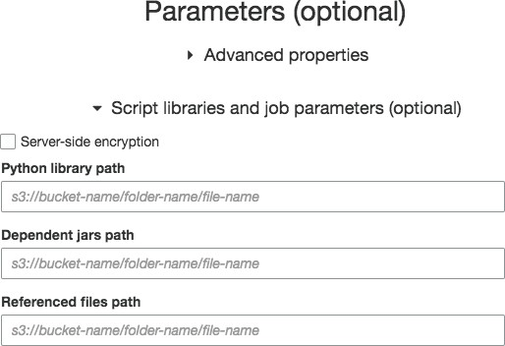
AWS Glue: Job Authoring – Import Custom Modules
Add external Python modules
Java JARs required by the script
Additional files such as configuration, etc.

Slide 29
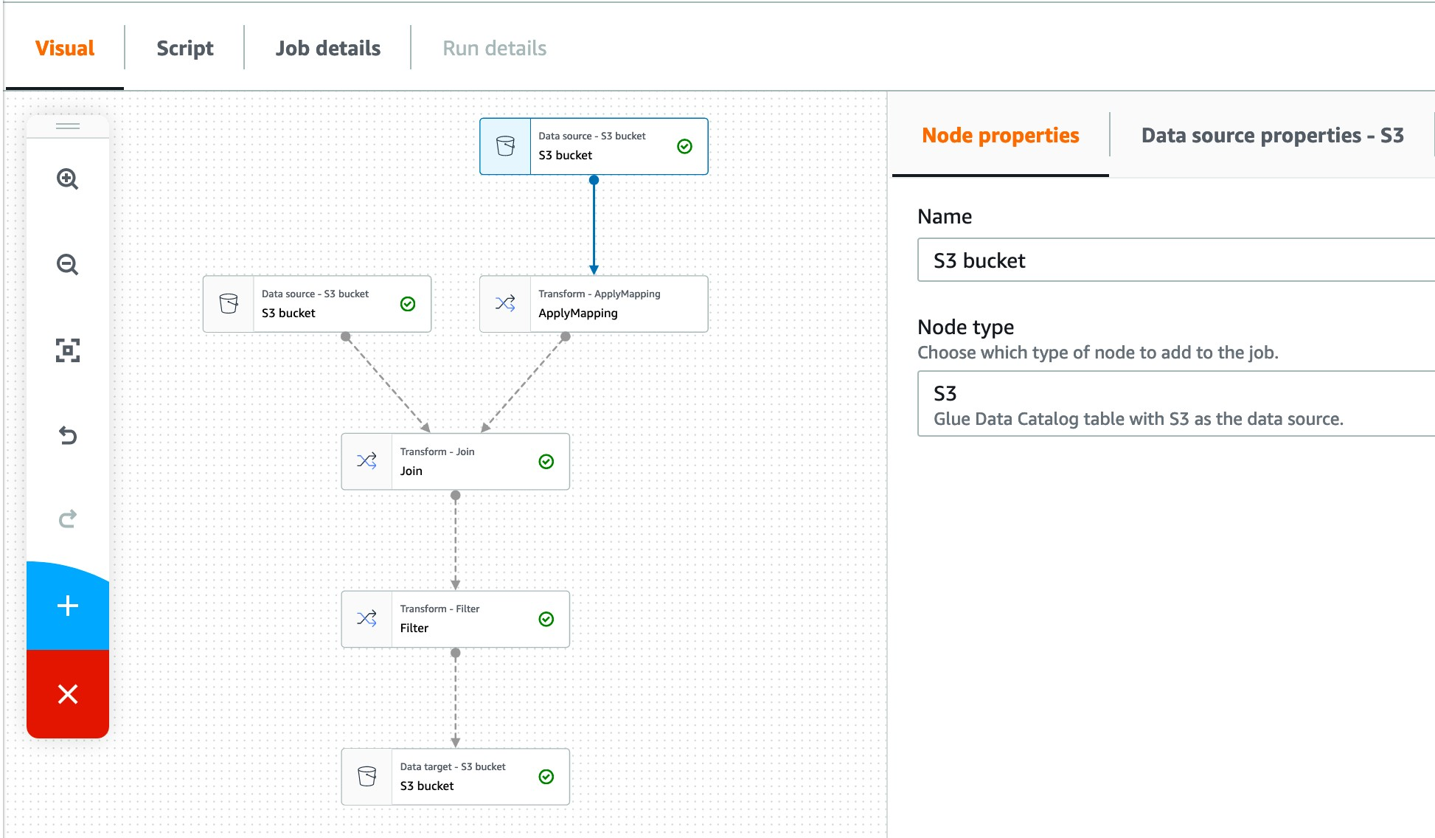

Slide 30

Apache Spark and AWS Glue ETL
What is Apache Spark?
Parallel, scale-out data processing engine Fault-tolerance built-in
Flexible interface: Python scripting, SQL Rich eco-system: ML, Graph, analytics, …
AWS Glue ETL libraries
Integration: Data Catalog, job orchestration, code-generation, job bookmarks, S3, RDS
ETL transforms, more connectors & formats New data structure: Dynamic Frames
SparkSQL
AWS Glue ETL
Dataframes Dynamic Frames
Spark core: RDDs

Slide 31



Dataframes and Dynamic Frames
Dataframes
Core data structure for SparkSQL Like structured tables
Need schema up-front
Each row has same structure
Suited for SQL-like analytics
Dynamic Frames
Like dataframes for ETL
Designed for processing semi-structured
data,
e.g. JSON, Avro, Apache logs ...

Slide 32






Job Authoring: Glue Dynamic Frames
Like Spark’s Data Frames, but better for:
Cleaning and (re)-structuring semi-structured
data sets, e.g. JSON, Avro, Apache logs ...
No upfront schema needed:
Infers schema on-the-fly, enabling transformations in a single pass
A
B1
B2
C
D [ ]
X
Y
Easy to handle the unexpected:
Tracks new fields, and inconsistent changing data types with choices, e.g. integer or string
Automatically mark and separate error records

Slide 33









Job Authoring: Glue transforms
Adaptive and flexible
project
cast
separate into cols
ResolveChoice()
B
B
B
B
B
B
B
C
Apply Mapping()
A
A
X
Y
X
Y

Slide 34






Job authoring: Relationalize() transform
Semi-structured schema
Relational schema
A
B
B
C.X
C.Y
FK
PK | Offset | Value
A
B B
C
D [ ]
X
Y
Transforms and adds new columns, types, and tables on-the-fly
Tracks keys and foreign keys across runs
SQL on the relational schema is orders of magnitude faster than JSON processing

Slide 35
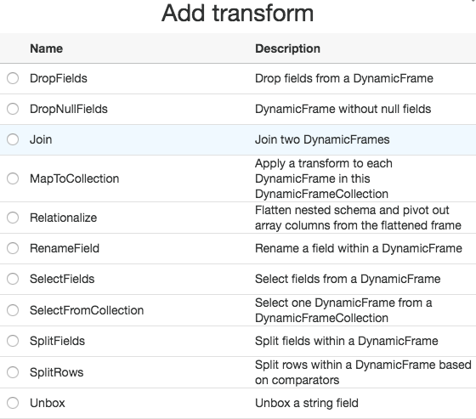
AWS Glue: Job Authoring – “DynamicFrame” High-Level API
Pre-Built Transformation click and add to your job with simple configuration
Spigot writes sample data from DynamicFrame to S3 in JSON format
Expanding with more transformations to come

Slide 36
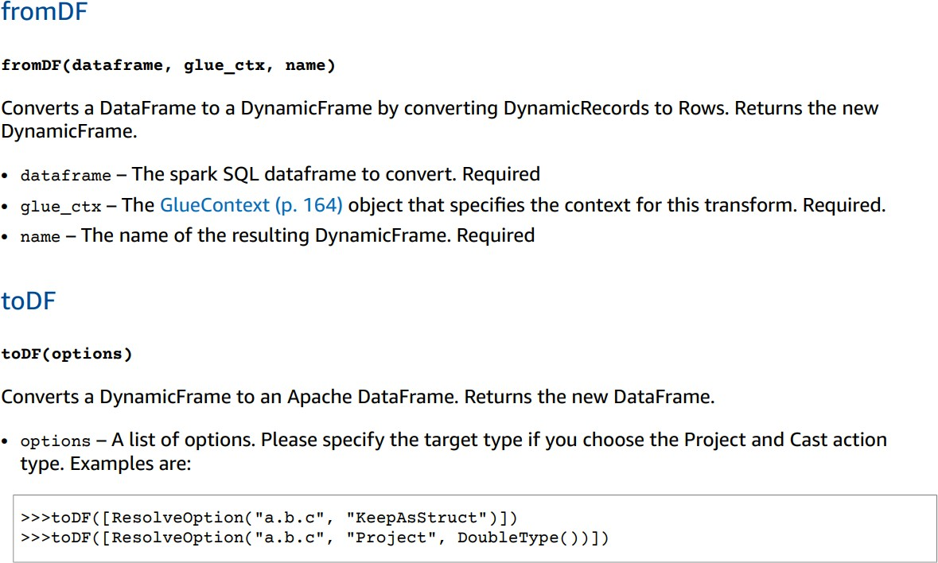
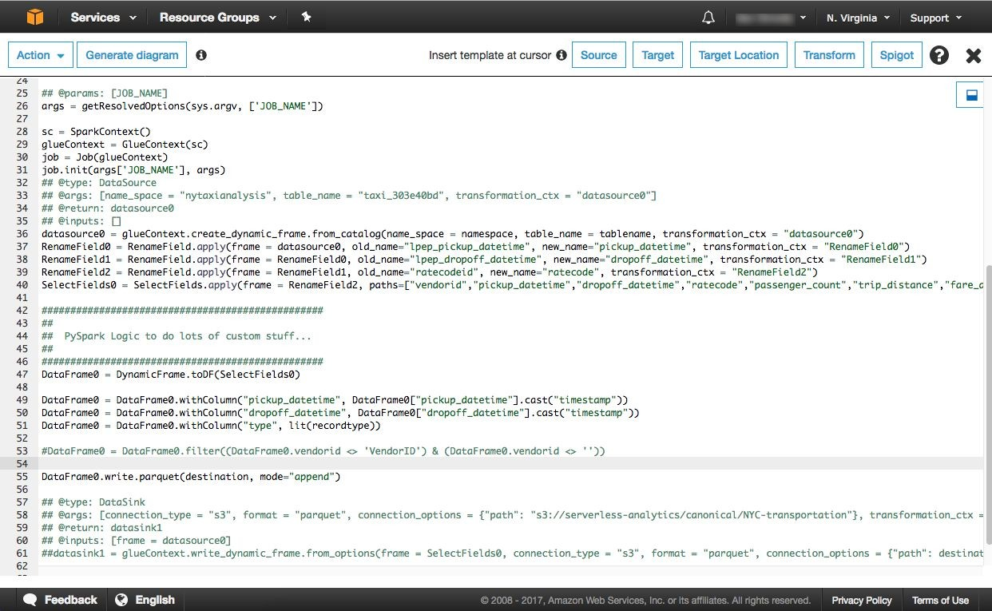
AWS Glue: Job Authoring – “DynamicFrame” High-Level API
Convert to and from Spark DataFrames
Run with custom code and libraries

Slide 37
AWS Glue: Components
Hive Metastore compatible with enhanced functionality
Crawlers automatically extracts metadata and creates tables
Integrated with Amazon Athena, Amazon EMR and many more
Data Catalog
Auto-generates ETL code
Build on open frameworks – Python/Scala and Apache Spark
Developer-centric – editing, debugging, sharing
Job Authoring
Run jobs on a serverless Spark platform
Provides flexible scheduling , Job monitoring and alerting
Job Execution
Orchestrate triggers, crawlers & jobs
Author & monitor entire flows and Integrated alerting
Job Workflow

Slide 38
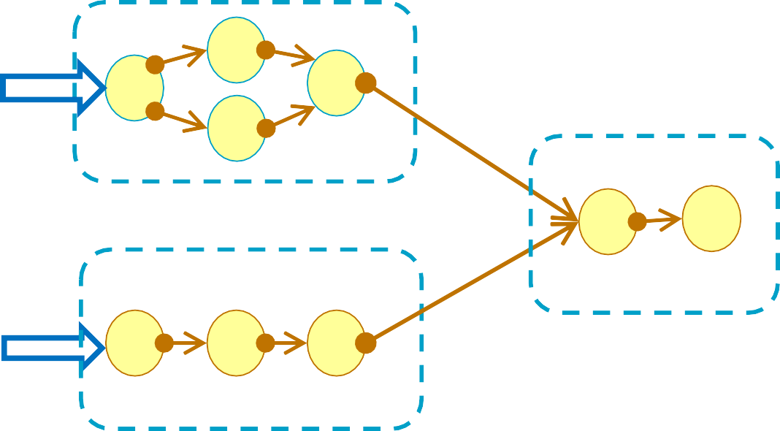
AWS Glue Orchestration
Compose jobs globally with event- based dependencies
Easy to reuse and leverage work across organization boundaries
Marketing: Ad-spend by customer segment
Event Based
Lambda Trigger
Data based
Multiple triggering mechanisms
Schedule-based: e.g., time of day
Event-based: e.g., job completion
On-demand: e.g., AWS Lambda
Schedule
y
Data based
Central: ROI by customer segment
Logs and alerts are available in Amazon CloudWatch
Sales: Revenue by customer segment

Slide 39
Job execution: Job bookmarks
Option | Behavior
Enable | Pick up from where you left off
Disable | Ignore and process the entire dataset every time
Pause | Temporarily disable advancing the bookmark
Glue keeps track of data that has already been processed by a previous run of an ETL job. This persisted state information is called a bookmark.
For example, you get new files everyday in your S3 bucket. By default, AWS Glue keeps track of which files have been successfully processed by the job to prevent data duplication.
Data objects
Marketing: Ad-spend by customer segment

Slide 40
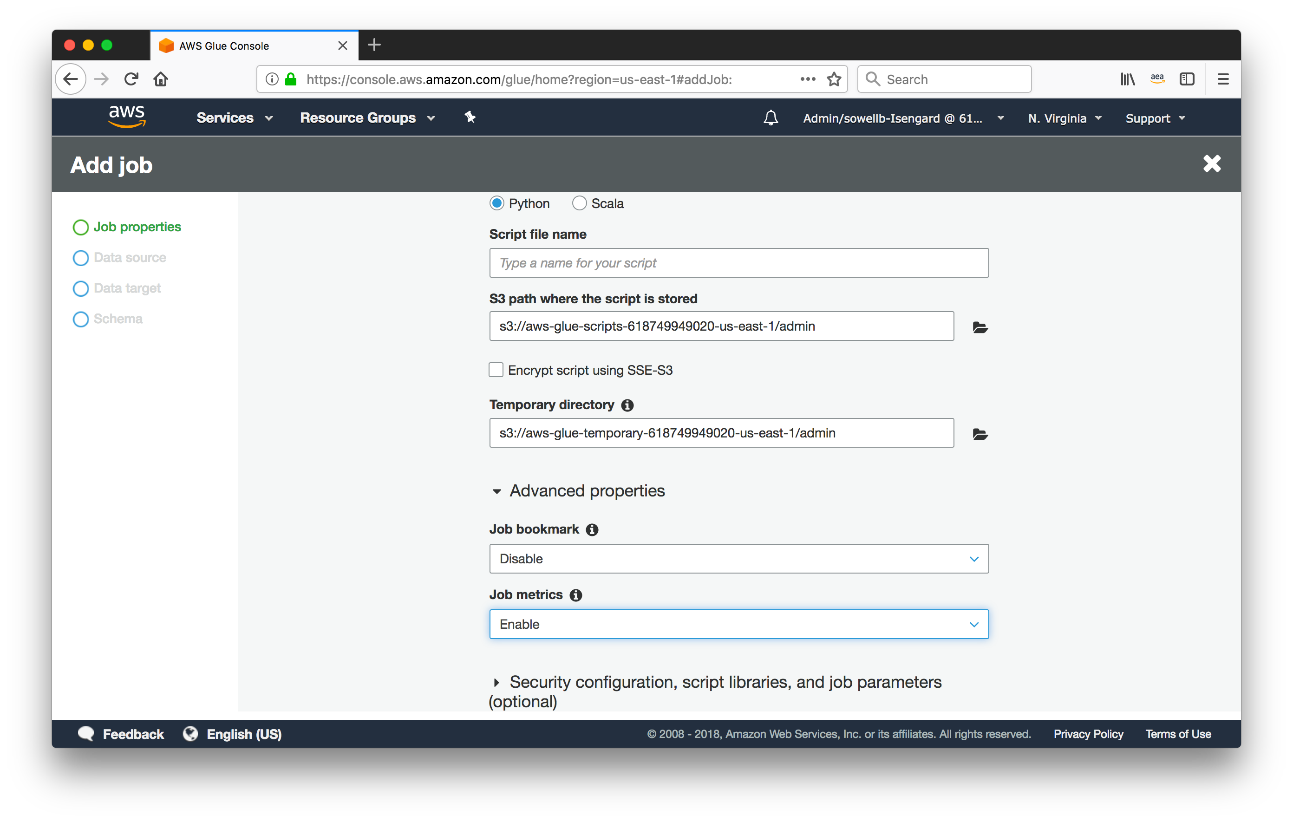
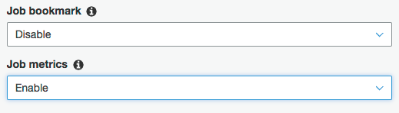
AWS Glue job metrics
Metrics can be enabled in the AWS Command Line Interface (AWS CLI) and AWS SDK by passing --enable-metrics as a job parameter key.

Slide 41
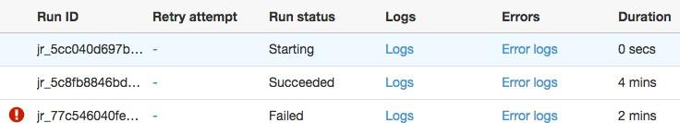
AWS Glue: Job Execution – Progress and History
Track ETL job progress and inspect logs directly from the console.
Logs are written to CloudWatch for simple access.
Errors are automatically extracted and presented in the Error Logs for easy troubleshooting of jobs.

Slide 42
Job Monitoring and Notification
Publish crawler and job notifications into Amazon CloudWatch Amazon CloudWatch events to control downstream workflows
External
Conditions
‘ANY’ and ‘ALL’ operators in Trigger conditions Additional job states ’failed’, ‘stopped’, or ‘timeout’
Control
Configure job timeout Job delay notifications
Build and automate a serverless data lake using an AWS Glue trigger for the Data Catalog and ETL jobs

Slide 43




AWS Glue: Job Execution - Serverless
There is no need to provision, configure, or manage servers
Auto-configure VPC and role-based access
Customers can specify the capacity that gets allocated to each job
Automatically scale resources (on post-GA roadmap)
You pay only for the resources you consume while consuming them
Compute instances

Slide 44
Glue worker types
DPU (Data Processing Unit) – 4 vCPU, 16GB, unit of pricing
Worker types
Standard – 2 executors/worker: 16 GB More memory per executor
G.1X – 1 executor/worker: 16 GB
G.2X – 1 executor/worker: 32 GB (2 DPU)

Slide 45
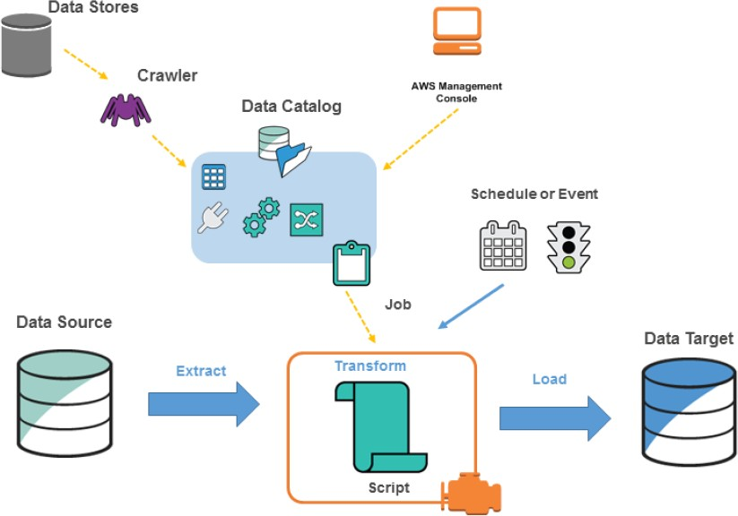
AWS Glue: Overall Flow
2. Create your desired targets
1. Crawl your raw data
4. Execute your job
3. Generate and prep your ETL

Slide 46







Python shell Job
A cost-effective (1 or 1/16 DPU!) ETL primitive for small to medium tasks
SQL-based ETL
Amazon Redshift
Amazon EMR
Custom Connectors
Amazon S3
AWS Glue
Python shell
3rd party service
Medium-size ML
AWS Deep Learning AMIs

Slide 47

AWS Glue: Components
Hive Metastore compatible with enhanced functionality
Crawlers automatically extracts metadata and creates tables
Integrated with Amazon Athena, Amazon EMR and many more
Data Catalog
Auto-generates ETL code
Build on open frameworks – Python/Scala and Apache Spark
Developer-centric – editing, debugging, sharing
Job Authoring
Run jobs on a serverless Spark platform
Provides flexible scheduling , Job monitoring and alerting
Orchestrate triggers, crawlers & jobs
Author & monitor entire flows and Integrated alerting
Job Execution
Job Workflow

Slide 48
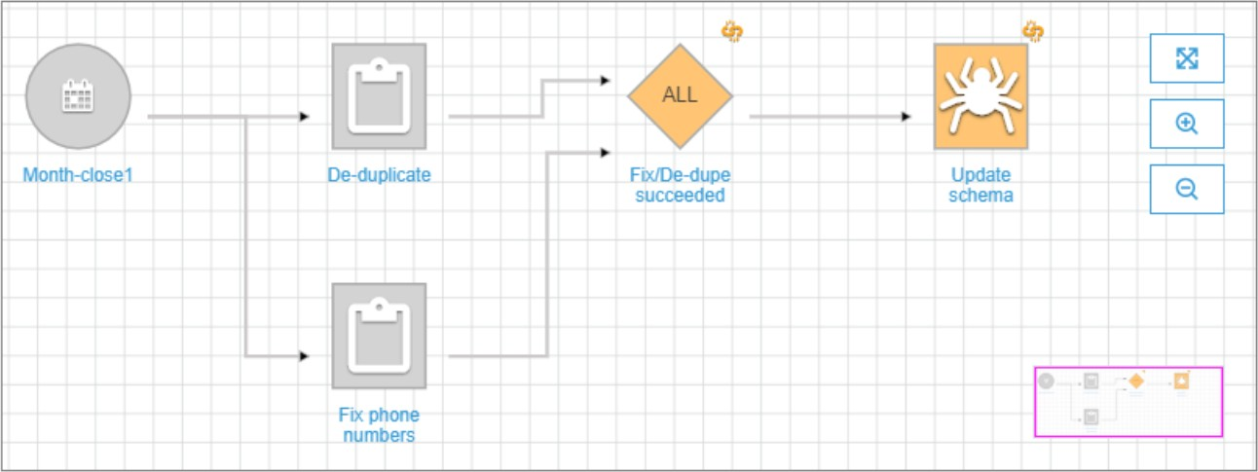
Glue Workflows
Create and visualize complex ETL activities involving multiple crawlers, jobs, and triggers
Records execution progress and status
Provide both static and dynamic view

Slide 49











Example event-driven workflow
Run “optimize” job
Crawl optimized dataset
New raw data arrives
Crawl
raw
dataset
Ready
for reporting
SLA
deadline
Start crawl
On-demand trigger
Start Crawl

Slide 50

Q & A

